Slide 1
Anime streaming site
Presented by: Dipesh Tha Shrestha
Presented To: Akash Deo

Slide 2
Anime streaming site
Anime websites are online collection of various animated movies, cartoons, and TV shows. You can browse these websites to find anime of action, drama, horror, kids, and more. Many such sites enable you to filter anime by season, year, quality, and language.

Slide 3
Some Popular Streaming Site
KissAnime
GoGoAnime
Chia-Anime

Slide 4
KissAnime
KissAnime is one of the largest anime streaming networks, and it boasts a rich community that helps you socialize with other anime fans and make different discussions.
The website is free to use and is supported through ads

Slide 5
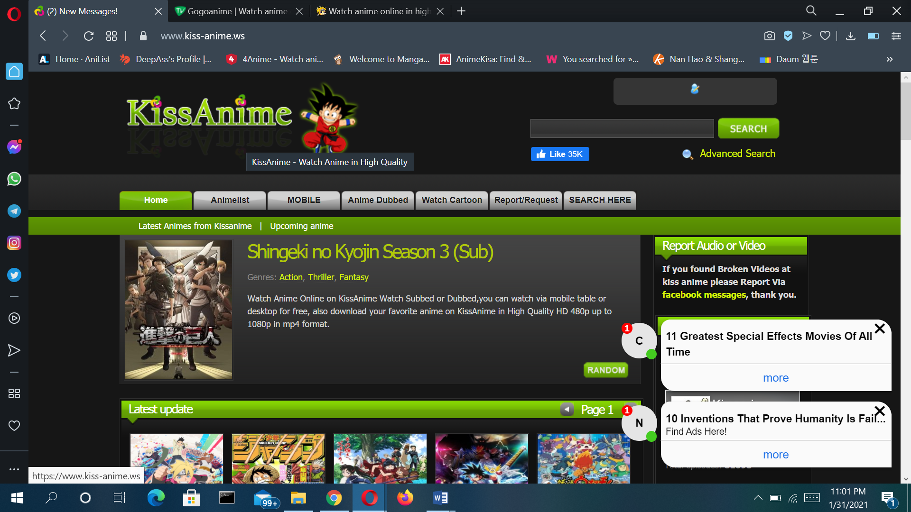
Offical site of KissAnime

Slide 6
Pros:-
The thumbnails have great animations which act as previews to what’s in the anime series episode or movie.
The categorization of videos is super convenient for the user.
The episodes and movies on the Kissanime website are of high quality and add to a fantastic user experience watching the same.

Slide 7
Cons:-
Since it is a free website, it is full of irritating advertisements that pop up multiple times. There are several complaints of even inappropriate adult advertisements.
You cannot change the video resolution on the website.
The website may ban you if you use an Adblocker or VPN.

Slide 8
Usability issues:-
A lot of inappropriate ads.
Requires signing captcha before watching specific anime series.
Unattractive design
Not compatible with all devices.
Unmanaged genres and library
Tiny text links

Slide 9
GoGoAnime
GoGoAnime is a great website where to watch anime for free.
This anime streaming site is fantastic because it provides you with exceptionally high-quality streaming services, and you will love this site.
The website also has a very user-friendly interface.

Slide 10
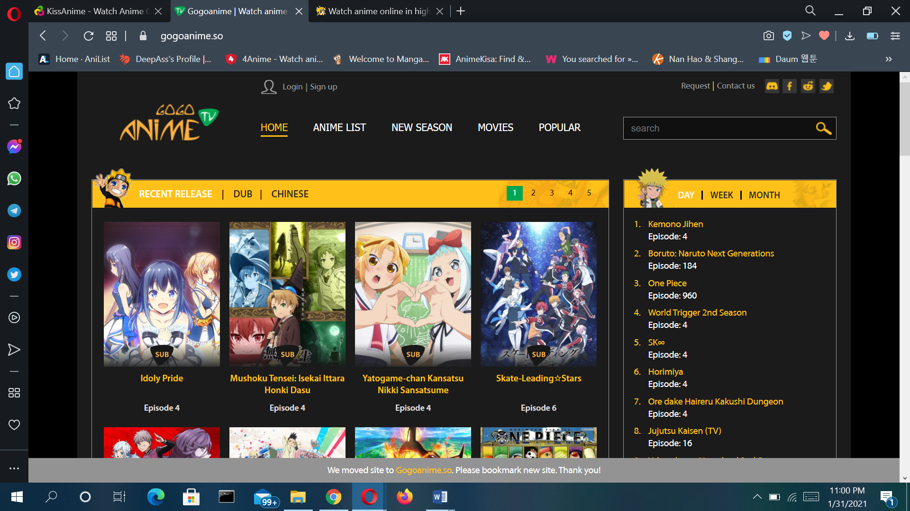
Offical website of GoGoAnime

Slide 11
Pros:-
The simple user interface which is very friendly and easy to navigate around
GoGoAnime website has a wide range of comics and anime series as well as movies, which will keep you entertained as and when you want to be
Other than having a wide range of manga and anime, GoGoAnime also has all the latest episodes
Adding to its other features, the near distance range for Asian as well as other servers is brilliant

Slide 12
Cons:-
Understandably, free content streaming websites need an income to run effectively, which is why there are ads on them. However, GoGoAnime is one such example of a site which has too many ads, to the point that it’s difficult to differentiate certain ads from the actual content
Aside from acknowledging the fact that the website for anime streaming GoGoAnime, has too many ads, we must also recognize that many of these are inappropriate adult ads. This is highly unsafe for children who like to stream Japanese cartoons.
You may accidentally download a virus off of this website due to its pop-ups.

Slide 13
System Charactertics of Streaming Site
light and dark themes.
low bandwidth.
Easy access.
Wide range of collection.
Compatibility with many devices.
Clean and catchy interface
Quick filter
Language change

Slide 14
User Characteristics of streaming site
These user characteristics encompass cognitive aspect, personality, demographics, and use behavior.
There is age restriction in some streaming website but most of the streaming website does not contain any age restriction.

Slide 15
Problem Identification
Some of these site is considered illegal and can have consequences.
You may accidentally download a virus off of this website due to its pop-ups.
Aside from acknowledging the fact that the website for anime streaming in this website, has too many ads, we must also recognize that many of these are inappropriate adult ads. This is highly unsafe for children who like to stream.

Slide 16
Conclusion:
All the anime streaming sites that are mentioned above are widely used all over the world. They are jumbo packages for the smooth streaming of anime movies or episodes. All the websites combine to help you with all genres, categories, and kinds of Anime, including martial arts, tv-series, graphic novels, and comics.

Slide 17
Thank you

